Slide 1
LESSON EIGHT
PREVENTING SEXUALLY TRANSMITTED INFECTIONS

Slide 2
Lesson 8 Preview
In health class, Tre was studying about the importance of eating healthy low fat foods, getting plenty of exercise and sleep, avoiding drugs and alcohol, and getting regular medical checkups from a local clinic.
Recently Tre had noticed …

Slide 3
Lesson 8 Preview
… a red bump on his leg. It was tender to the touch, and about the size of a quarter. Tre didn’t remember getting any wound or insect bite, and hoped it would go away in a few days.
But now the sore was getting larger and more tender.

Slide 4
Lesson 8 Review Questions
Briefly summarize the facts of the story.
Do you think Tre should continue to see what happens to the sore? Why or why not?
Who should Tre tell about the sore?
Can you name at least two places in your community to get a health check-up?

Slide 5
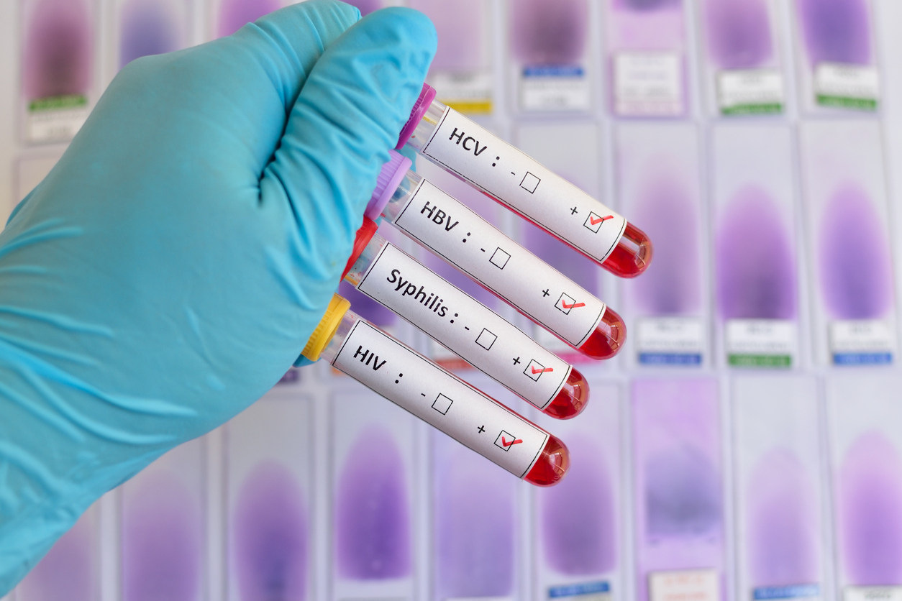
Today’s Lesson Objectives
Identify/describe common STIs and their symptoms.
Describe ways that STIs can be transmitted.
Identify community resources for STI testing and treatment.

Slide 6
Evidence of Achievement
You completed the STI and Lesson Wrap-Up worksheets.
You completed the lesson activities.
You made a commitment to be free of STIs.

Slide 7
What do the Letters STI Stand for?
S
T
I
Sexually: Related to having sexual contact.
Transmitted: Passed from one person to another.
Infection: An invasion of bacteria, viruses, or parasites not normally found in the body.
7

Slide 8
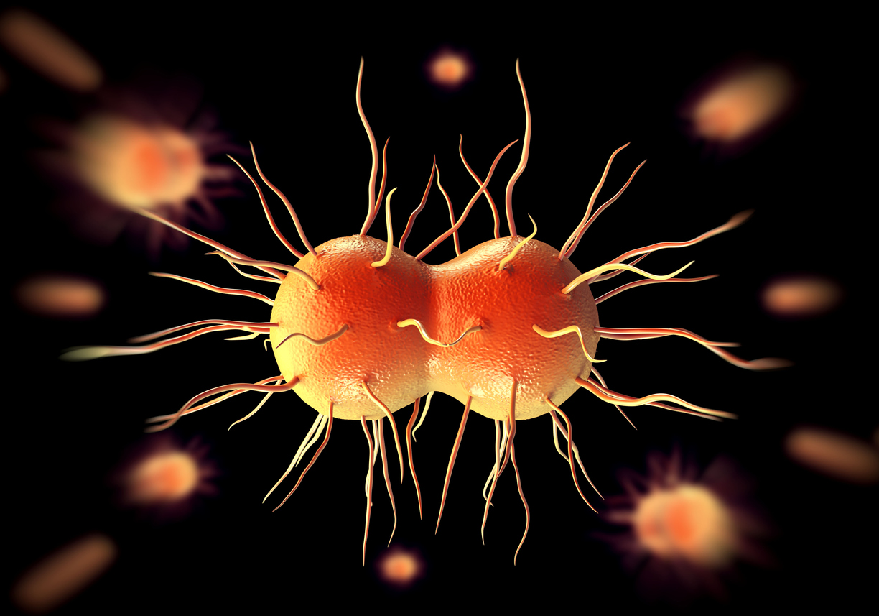
What STIs have you heard of?
Chlamydia
Gonorrhea
Hepatitis B
Herpes
HIV
HPV
Pubic Lice
Syphilis

Slide 9
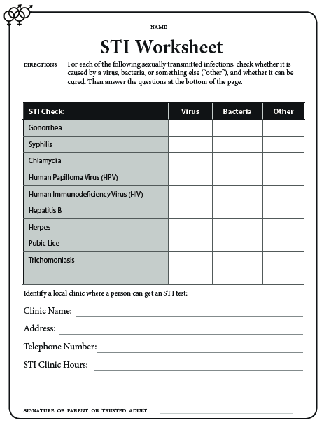
STI Worksheet
Complete the worksheet as you watch the slideshow on common STIs.
STI slide show

Slide 10
STI Bulletin Board Activity
VIRUS
Other
?
Bacteria

Slide 11
When to Get Tested
If you have had sexual contact with another person.
If you are planning to have sexual contact.
When you have symptoms.
If you have been exposed to an STI.
If you are pregnant.

Slide 12
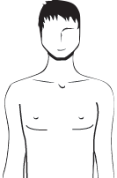
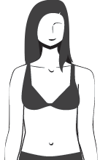
What are the symptoms of STIs?
A drip or drainage from the penis
Burning or itching in genital area
Swelling of one or both testicles
Sores, bumps, or blisters near sex organs or mouth
Burning or pain when urinating
Swelling or redness in throat
Swelling of lymph nodes near genitals, or swelling of genitals
Needing to urinate often
Vaginal discharge or odor
Deep pain in pelvis or vagina
Burning or itching of the vagina
Bleeding from the vagina other than regular menstrual flow
The most common symptom is NO SYMPTOM at all!

Slide 13
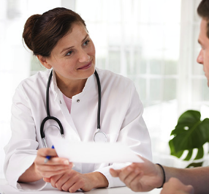
STI WARNING
Get an STI check-up.
If infected, get treatment.
If infected, always notify sex partners.
Be sure to protect yourself from further infection.
REMEMBER: Abstinence or consistent and correct use of condoms are the only ways to protect against STIs.

Slide 14
Public Health Departments
Your local public health department staff can:
Notify your partner(s) of their risk status confidentially.
Provide counseling for you and your partner(s).

Slide 15
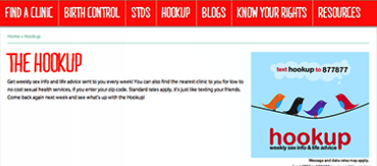
Locating a Local Health Clinic
In California, to locate a clinic visit www.familypact.org or www.teensource.org
Text CLINIC and your ZIP CODE to 877-877

Slide 16
Lesson Wrap-Up Part 1
Common STIs in young adults include chlamydia, gonorrhea, and human papilloma virus (HPV).
The only way an STI can spread from one person to another is through penis-vagina contact.
The most common symptom of an STI is nothing.
TRUE
FALSE
TRUE

Slide 17
Lesson Wrap-Up Part 2
Ask a Friend
Turn to a partner to check your answers and tell her/him the most important or interesting thing you learned during this lesson.

Slide 18
Lesson Wrap-Up Part 3
Ask Yourself
How committed are you to protect yourself and others from an STI?

Slide 19
Lesson Wrap-Up Part 4
Ask a Parent/Guardian or Trusted Adult to:
Review your STI and Lesson Wrap-Up worksheets.
Tell you what STIs they were aware of as teens, and what would they would recommend to someone if he/she thought he/she might have an STI.

Slide 20
Remember to do your homework!
Take home your worksheet/workbook to discuss with your parent or trusted adult and get their signature on completed worksheets, and complete the Lesson Preview for tomorrow’s lesson.
19

Slide 21
LESSON EIGHT
PREVENTING SEXUALLY TRANSMITTED INFECTIONS

